Slide 1
Peer feedback, peer assessment and Peergrade – why and how Workshop Faculty of Engineering March 2020
Inger-Marie F. Christensen, imc@sdu.dk

Slide 2
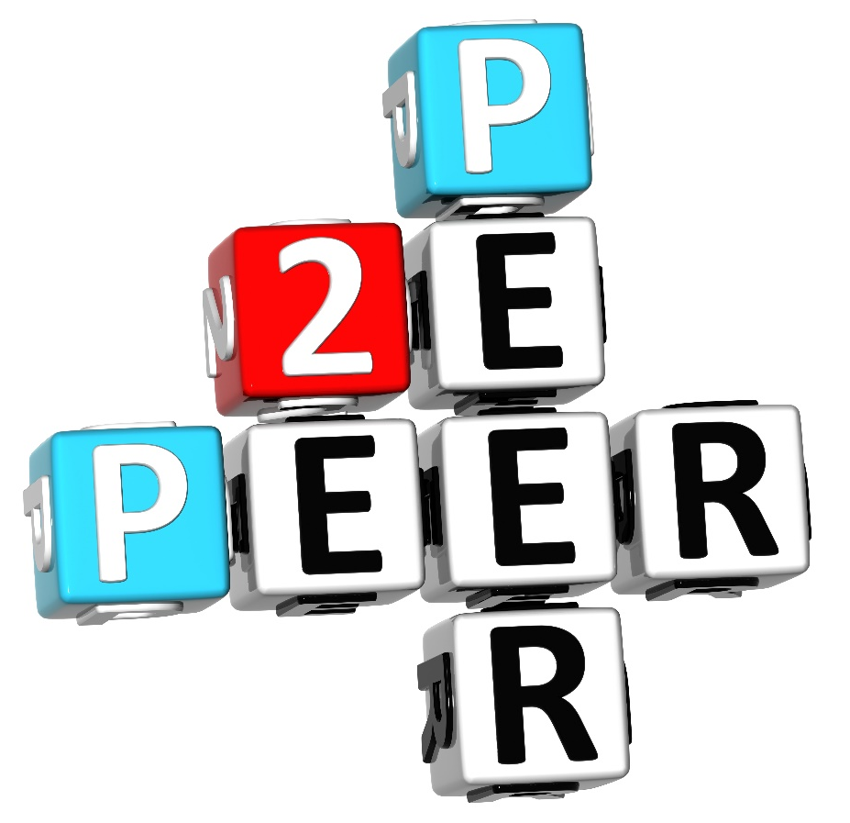
Workshop agenda
What is effective feedback?
What is peer feedback?
Why peer feedback?
Introduction to the system Peergrade
Try out Peergrade as a student
How to get started using Peergrade in your teaching or super vision

Slide 3
1. Feed up
Where am I going?
Feedback
How am I going?
Feed forward
Where to next?
What progress am I making towards the learning goal?
What do I need to do to make better progress?
Clarification of goals and criteria
Hattie and Timperley, 2007
Notes:
Feed up – where am I going clarifying the learning goals at the start and during a course leading up to the assessment
Feedback – focusing on how well a learner is doing, what progress are they making towards the learning goal
Feed forward – where to next?

Slide 4
Four levels of feedback
Task level
How well was the task understood and solved?
Correct/wrong
Difficult to transfer
Too much = trial/error
Surface learning
Process level
Strategies for solving assignments
Seeing connections
Creating meaning
Deep learning
Self-regulation level
Inner feedback
Self assessment
Self-regulated learning
Readiness to seek and act on feedback
Self level
Personal assessment
Praise
Does not support learning
Praise on strategies for solving assignments can have some effect
"This section may make more sense if you use the data analysis strategies we discussed in class."
"You need to include more about topic X"
"You already know the principles for developing an argument. Check to see whether you have incorporated them in the opening section of your paper.”
"You are a great student… That's an intelligent response, well done."

Slide 5
Assessment FOR or OF learning?
Formative assessment
Feedback, feed forward and feed up
Course start
Assessment FOR learning
‘Action without feedback is completely unproductive for the learner’ (Laurrilard, 2002).
Summative assessment
Feedback
Assessment OF learning
Course end, final exam

Slide 6
Students need PURT feedback to develop
P
Peer feedback?
Personal
U
Understandable
R
Relevant
T
Timely

Slide 7
Peer assessment (PA) is
‘an arrangement in which individuals consider the amount, level, value, worth, quality or success of the products or outcomes of learning of peers of similar status.’
(Topping, 1998, p. 250. Quoted from Panadero, Jonsson & Strijbos, 2016, p. 319)
Large variety of PA practices:
Purpose: formative or summative
Format:
With or without marks/grades
With or without comments/feedback
Degree of interaction between peers
(Panadero, Jonsson & Strijbos, 2016, p. 319)

Slide 8
Peer feedback
Assessment FOR learning
A communication process through which learners enter into dialogues related to performance and criteria
Primarily about rich detailed comments but without formal grades
(Liu & Carless, 2006)

Slide 9
What are the benefits and learning potential of peer assessment
Students take an active role in the management of their own learning
Students develop objectivity in relation to criteria
Can help students to more realistically self-assess
(Summarised in Liu & Carless, 2006)
Notes:
Active role: external feedback – can monitor own learning

Slide 10
What are the benefits and learning potential of peer feedback
Students will receive more feedback from peers more quickly (PURT)
Enhances student learning
Learning is extended from the private and individual to a more public domain
(Summarised in Liu & Carless, 2006)
Notes:
Enhances student learning – more time on task – more in depth learning

Slide 11
What roles do the teacher and students play?
Teacher is the expert
Teacher checks misconceptions
Teacher introduces new concepts
Teacher will assess learning outcomes
Teacher has limited time (PURT)
Peers have more immediate understanding of peer learning challenges (PURT)
Peer feedback is often more understandable (PURT)
We self assess our understanding when we are explaining what we understand to others
Peer feedback can be more timely (PURT)
Peer feedback is personal (PURT)
Engaging with peer feedback can help us optimise teacher/expert feedback

Slide 12
Introduction to PeerGrade.io
Students
submit their work
Students
assess and provide feedback
Students
respond to and rate feedback received

Slide 13
Try the system as a student
Go to peergrade.io/join
Type in this code UN9QWB
Click Next
Follow instructions on screen to join
Login as SDU user
Your tasks
Write essay (20 min.)
Give feedback to two peers (10 min.)
Assess own essay (5 min.)
Respond to feedback received (5 min.)

Slide 14
Implementing peer assessment in the classroom
Tailor PA activities
Learning goals
Tasks & timing
Context
Students
Secure alignment

Slide 15
Helping students engage with peer feedback activities

Slide 16
1. Create Classroom
2. Create assignment and rubric questions
3. Enrol “Students”
Creating peer feedback activities in Peergrade 1

Slide 17
4. Students upload assignment
5. Students give and respond to feedback
6. Monitor process and make judgements in case of divergence
Creating peer feedback activities in Peergrade 2
Notes:
60 minutes

Slide 18
Change role from student to teacher
You may have to refresh your browser or close and open it again to make the changes apply.

Slide 19
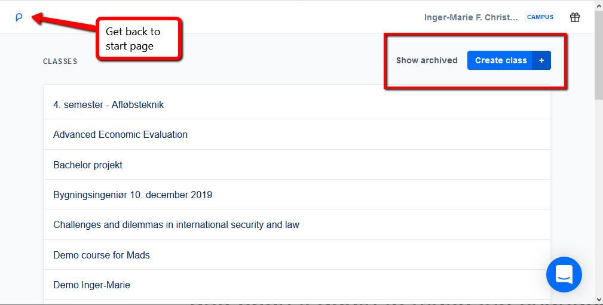
Create your own peer feedback activities

Slide 20
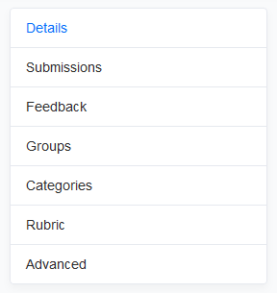
Peer feedback activities
Live session
continuous flow without deadlines
Homework
deadline for submission and feedback
Rubric library – reuse rubrics
Anonymous or not
Set number of reviews
Self evaluation or not
Group assignments and peer feedback

Slide 21
Discussion
What potentials and challenges do you see in relation to using peer feedback and Peergrade.io in your teaching and supervision?

Slide 22
What’s next?
Request course on peer feedback, assessment and Peergrade
https://www.conferencemanager.dk/peer-feedback-spring2020
Create peer feedback activities for your students in Peergrade
Book an e-learning consultant to help you plan peer feedback activities
Study the resources in the list of references at the end of this presentation
Spiller text good starting point

Slide 23
References
Carless, D. (2019). Feedback loops and the longer-term: towards feedback spirals. Assessment & Evaluation in Higher Education, 44:5, 705-714. doi:10.1080/02602938.2018.1531108
Cho, K., & MacArthur, C. (2010). Student revision with peer and expert reviewing. Learning and Instruction, 20(4), 328-338. doi:10.1016/j.learninstruc.2009.08.006.
Cho, K., & MacArthur, C. (2011). Learning by reviewing. Journal of Educational Psychology, 103(1), 73-84. doi:10.1037/a0021950.
Falchikov, N. (2001). Learning together: Peer tutoring in higher education. London: Routledge.
Hattie, J. and Timperely, H. (2007) ‘The Power of Feedback’ Review of Educational Research. 77: 1, 87-112.
Laurillard, D. (2002). Rethinking university teaching: A conversational framework for the effective use of learning technologies. 2nd edn, London: RoutledgeFalmer.
Liu, N.-F. and D. Carless (2006). "Peer feedback: the learning element of peer assessment." Teaching in Higher Education 11(3): 279-290.
Nicol, D., Thomson, A., & Breslin, C. (2014). Rethinking feedback practices in higher education: a peer review perspective. Assessment & Evaluation in Higher Education, 39(1), 102-122. doi:10.1080/02602938.2013.795518.
Panadero, E., Jonsson, A., Strijbos JW. (2016) Scaffolding Self-Regulated Learning Through Self Assessment and Peer Assessment: Guidelines for Classroom Implementation. In Laveault D., Allal L. (eds). Assessment for Learning: Meeting the Challenge of Implementation. The Enabling Power of Assessment, vol 4, pp. 311-326. Springer International Publishing.
Sambell, K., McDowell, L. & Montgomery, C. (2012). Assessment for Learning in Higher Education. New York: Routledge.
Spiller, D. (2012). Assessment Matters: Self-Assessment and Peer Assessment. Teaching Development Unit. University of Waikato.

